Slide 1
QuickStart for MetaWare Risc-V VSCode based IDE
2024-05-17

Slide 2
Outline
Introduction
Perquisite
Installation of this extension
Building and Running HelloWorld project

Slide 3
Introduction
The next generation IDE enable the end customer to develop project based on MetaWare toolchain and MetaWare nSIM for MetaWare Risc-V Series inside Microsoft VS Code GUI.
Perquisite:
MetaWare nSIM --- simulator that support MetaWare Risc-V series.
MetaWare toolchain --- toolset include compiler/debugger that support MetaWare Risc-V series.
VS Code --- Popular cross-platform IDE developed by Microsoft.
PlatformIO --- Popular development environment for embedded industry on top of VS Code.

Slide 4
QuickStart for MetaWare Risc-V VSCode based IDE
Introduction
Perquisite
Installation of nSIM
Installation of VS Code
Installation of PlatformIO core
Installation of this extension --- platformio-metaware-riscv
Installation of toolchain
Installation of builder and uploader
Building and Running HelloWorld project
Building HelloWorld project
Running HelloWorld project

Slide 5
QuickStart for MetaWare Risc-V VSCode based IDE
Introduction
Perquisite
Installation of nSIM
Installation of VS Code
Installation of PlatformIO core
Installation of this extension --- platformio-metaware-riscv
Installation of toolchain
Installation of builder and uploader
Building and Running HelloWorld project
Building HelloWorld project
Running HelloWorld project

Slide 6
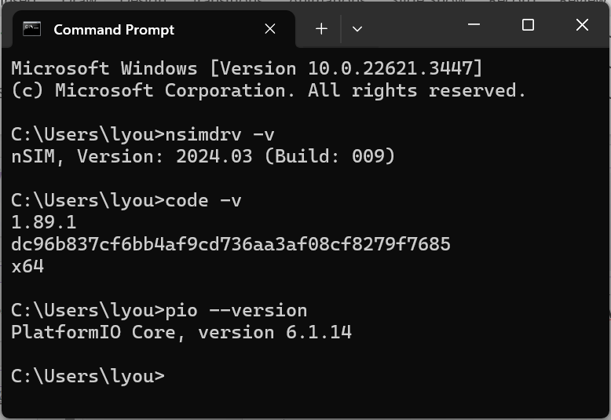
Perquisite
Follow official doc to install MetaWare nSIM + VS Code + PlatformIO
WIN CMD console to double check the success of these installations.
nsimdrv –v ## nSIM’s version
code –v ## VS Code version
pio –version ## platformIO version

Slide 7
QuickStart for MetaWare Risc-V VSCode based IDE
Introduction
Perquisite
Installation of nSIM
Installation of VS Code
Installation of PlatformIO core
Installation of this extension --- platformio-metaware-riscv
Installation of toolchain
Installation of builder and uploader
Building and Running HelloWorld project
Building HelloWorld project
Running HelloWorld project

Slide 8
Installation of the IDE Extension
The codebase of the IDE extension
https://github.com/foss-for-synopsys-dwc-arc-processors/platformio-metaware-riscv
Git clone and into HelloWorld project
Installation of toolchain
pio pkg install --tool toolchain-gccmetaware=https://github.com/foss-for-synopsys-dwc-arc-processors/platformio-metaware-riscv/blob/toolchain/toolchain-gccmetaware.zip
Installation of builder and uploader
pio pkg install --platform metaware_riscv=https://github.com/foss-for-synopsys-dwc-arc-processors/platformio-metaware-riscv.git#main

Slide 9
QuickStart for MetaWare Risc-V VSCode based IDE
Introduction
Perquisite
Installation of nSIM
Installation of VS Code
Installation of PlatformIO core
Installation of this extension --- platformio-metaware-riscv
Installation of toolchain
Installation of builder and uploader
Building and Running HelloWorld project
Building HelloWorld project
Running HelloWorld project

